Slide 1
Advanced Algorithm for Enhancement of Fashion Imagery
By Jean-Luc Peloquin
Final Project: CS 469/669
Spring 2024

Slide 2
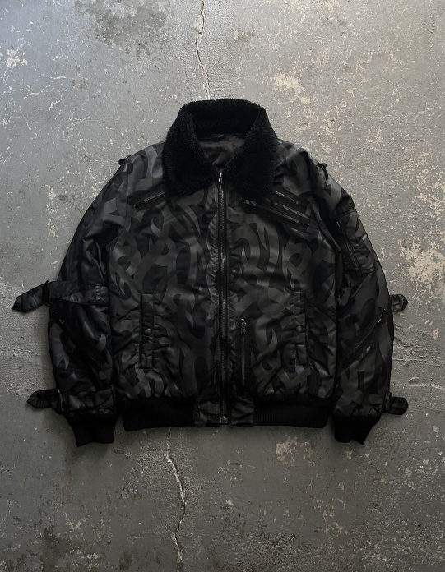
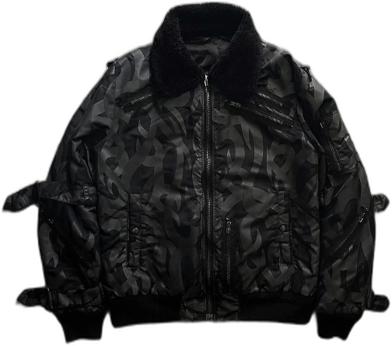
Outline
Introduction
Methodology
Results and Analysis
Conclusion
References and Questions

Slide 3
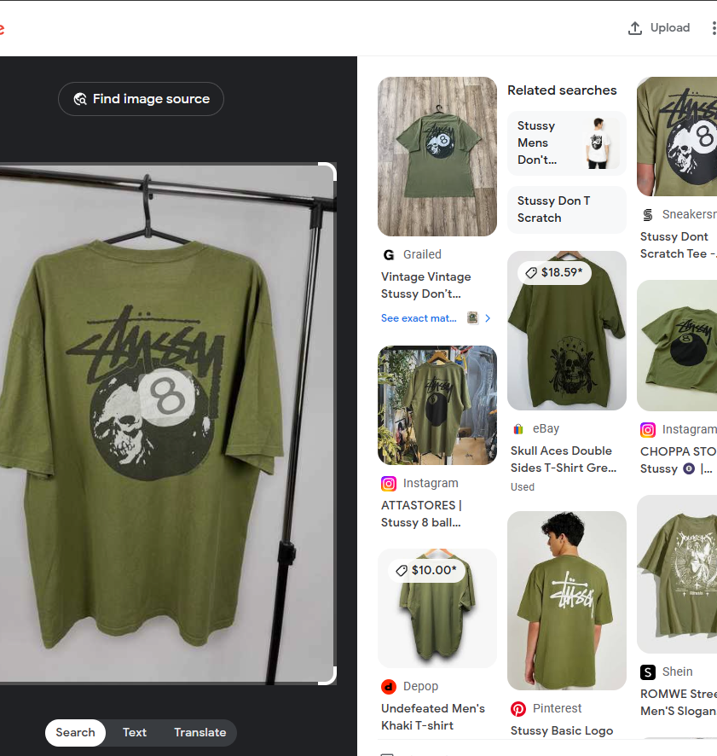
Introduction
Problem
Reverse image searching results either pretty accurate or too broad
Reason
Image quality on blurry images with distracting backgrounds
Solution
Create an application to automatically upscale and improve clarity on given image(s) with a focus on speed and no user interaction

Slide 4
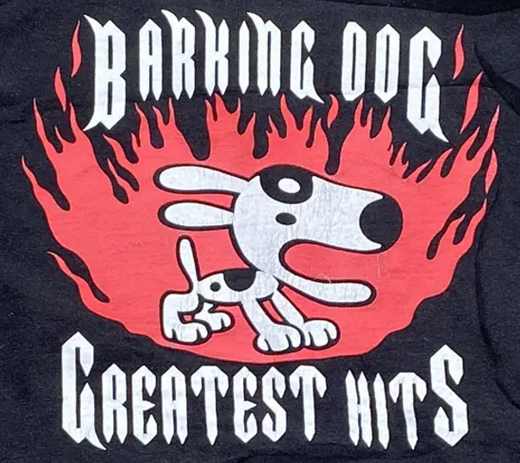
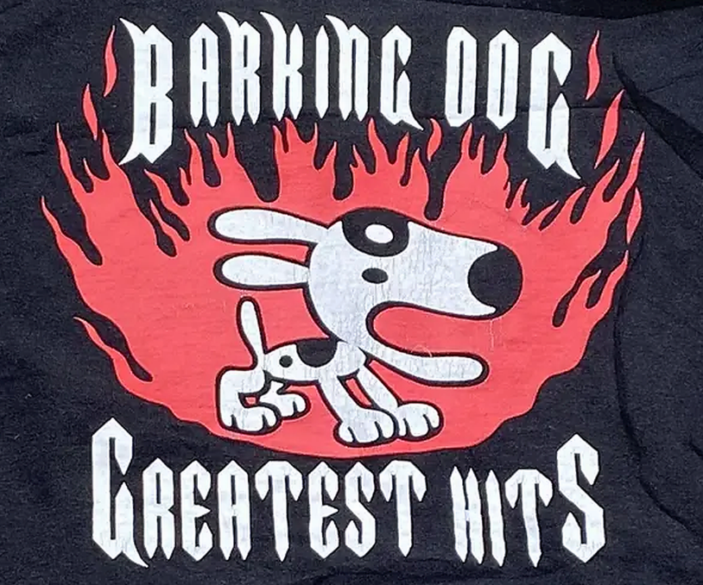
Methodology
Upscaling
Lanczos algorithm
Detail Enhancement
High-pass filtering
Unsharp Masking
Background Removal
rembg() ML algorithm
Cropping and Conversion
Contour-based cropping of transparent empty space (to .png)
Dataset
Web scraped from Grailed.com

Slide 5
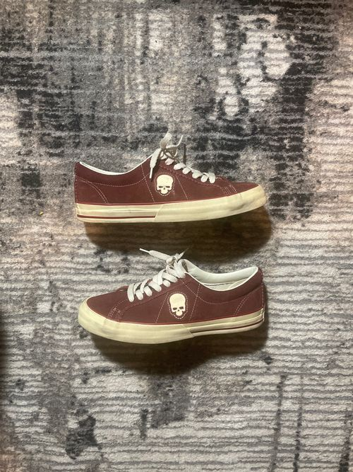
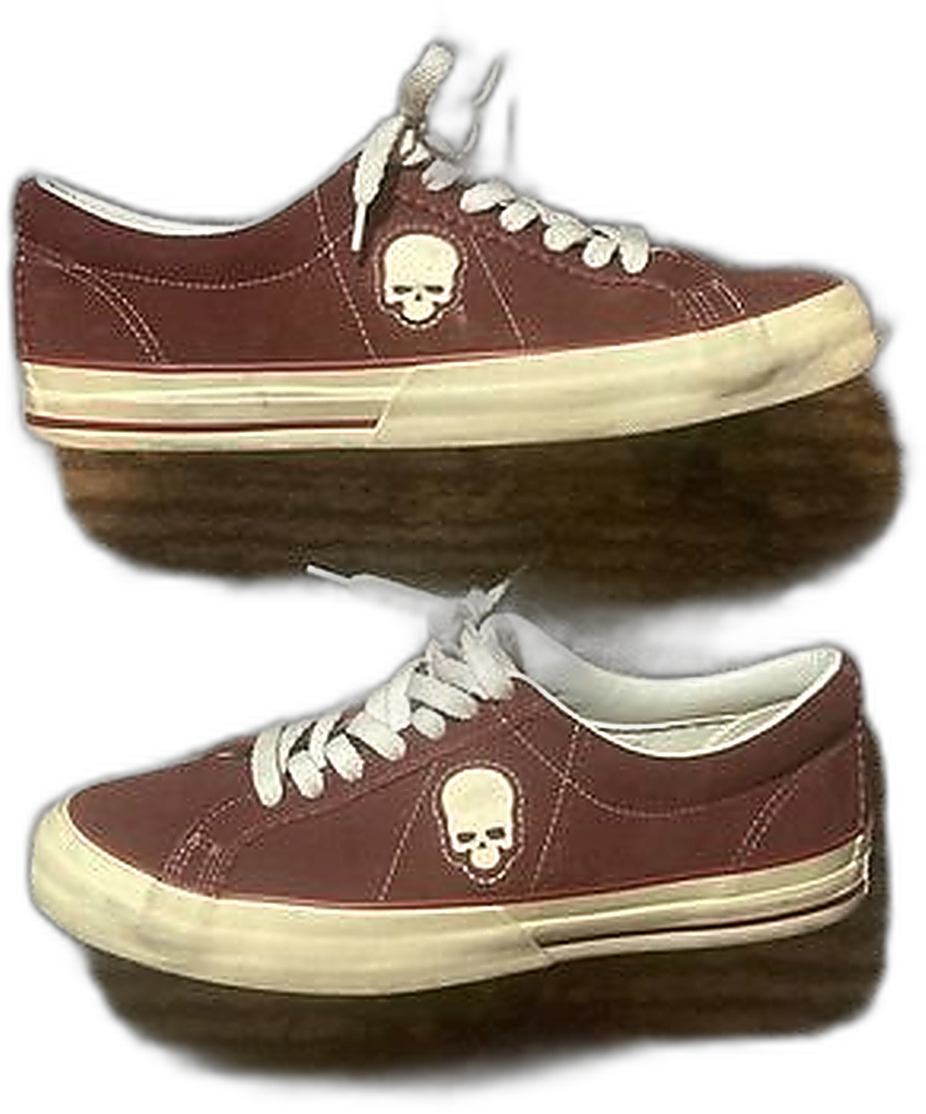
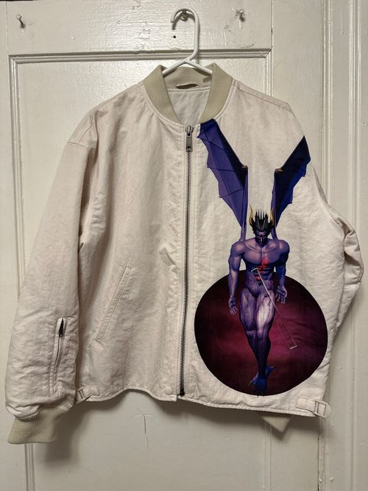
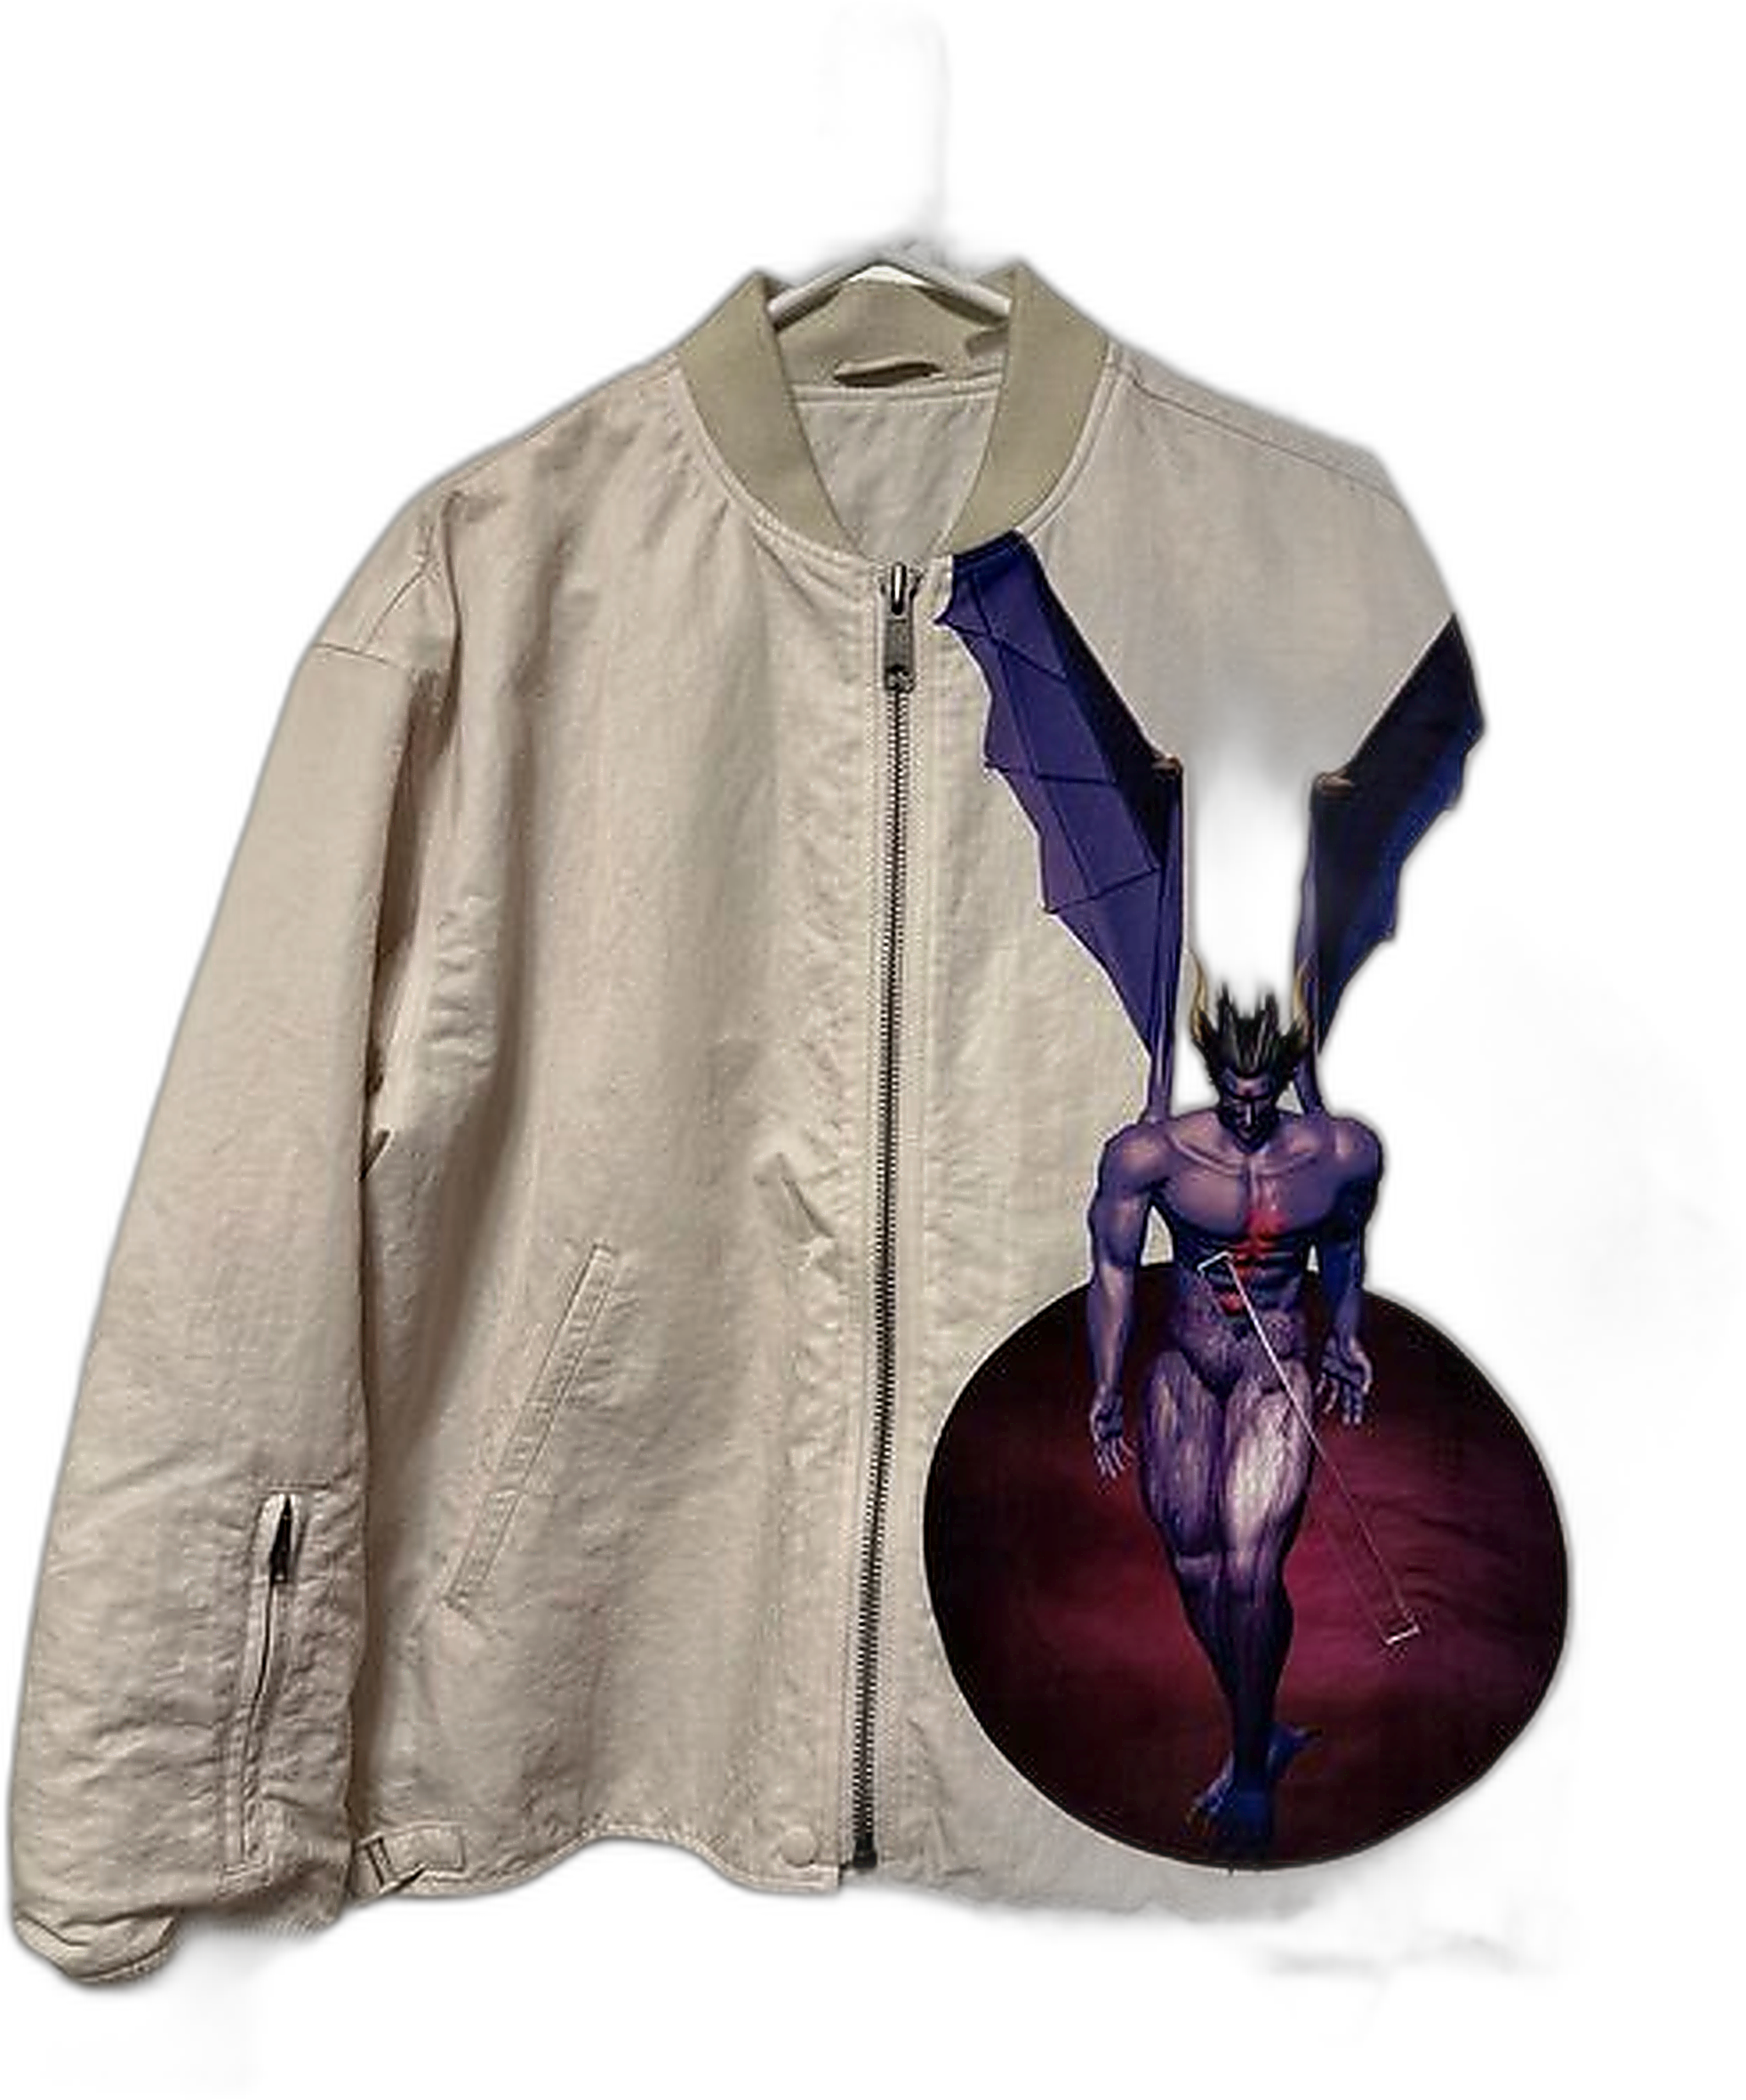
Results and Analysis
Higher Res = More Computational Time (Lanczos Upscaling)
Improves all images regardless of results
All enhanced in quality w/ background removal
Limitations
Images with complex backgrounds / shadows
Images with initial poor image quality do not get enhanced as well as medium-high quality
Less sample size for pixels to enhance

Slide 6
Conclusion
Faster than Photoshop (6 sec per image average)
Larger size image takes much longer (prob doesn’t need processing anyways)
Easy to use GUI with minimal input
Quality of initial image results in better or worse results
ex: smaller images become much clearer, but background removal is more variable
Accuracy in reverse image searching only improves
At very worst does nothing
At best increases results

Slide 7
References and Questions
[1] Adobe, “Smooth enhance fabric with generative fill,” Adobe Photoshop Tutorials,
2024. [Online]. Available:
https://creativecloud.adobe.com/learn/photoshop/web/smooth-enhance-fabricgenerative-fill. [Accessed: Apr. 28, 2024].
[2] “Lanczos resampling,” Wikipedia, 2024. [Online]. Available:
https://en.wikipedia.org/wiki/Lanczos_resampling. [Accessed: Apr. 28, 2024].
[3] “High-pass filter,” Wikipedia, 2024. [Online]. Available:
https://en.wikipedia.org/wiki/High-pass_filter. [Accessed: Apr. 28, 2024].
[4] Cambridge in Colour, “Unsharp mask,” 2024. [Online]. Available:
https://www.cambridgeincolour.com/tutorials/unsharp-mask.html. [Accessed: Apr. 28,
2024].
5
[5] “rembg,” PyPI, 2024. [Online]. Available: https://pypi.org/project/rembg/.
[Accessed: Apr. 28, 2024].
[6] “Image background removal,” YouTube, uploaded by D. Gatis, 2024. [Online].
Available: https://www.youtube.com/watch?v=2X9rxzZbYqg. [Accessed: Apr. 28,
2024].
[7] Grailed, “Grailed,” 2024. [Online]. Available: https://www.grailed.com/. [Accessed:
Apr. 28, 2024].
[8] Data to Fish, “How to convert JPEG to PNG in Python,” 2024. [Online]. Available:
https://datatofish.com/jpeg-to-png-python/. [Accessed: Apr. 28, 2024].
[9] “Plyer documentation,” Read the Docs, 2024. [Online]. Available:
https://plyer.readthedocs.io/en/latest/. [Accessed: Apr. 28, 2024].
[10] “Pillow documentation,” Read the Docs, 2024. [Online]. Available:
https://pillow.readthedocs.io/en/stable. [Accessed: Apr. 28, 2024].
[11] D. Gatis, “rembg,” GitHub, 2024. [Online]. Available:
https://github.com/danielgatis/rembg. [Accessed: Apr. 28, 2024].
[12] “NumPy documentation,” NumPy, 2024. [Online]. Available:
https://numpy.org/doc/. [Accessed: Apr. 28, 2024].
[13] “OpenCV documentation,” OpenCV, 2024. [Online]. Available:
https://docs.opencv.org/4.x/d6/d00/tutorial_py_root.html. [Accessed: Apr. 28, 2024]

